Slide 1
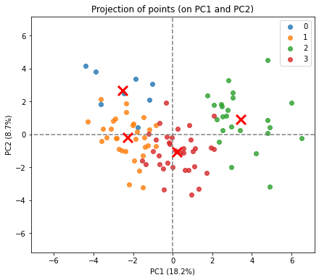
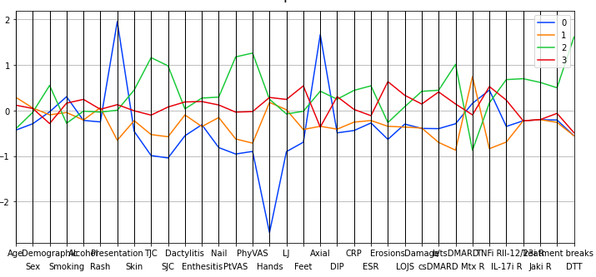
Difficult to treat Psoriatic arthritis: Lack of response to methotrexate and prolonged treatment breaks predict refractory disease.
Dr Devika Dua¹, Dr Nicola Gullick²
Background
Figures
Findings
Clinical progress in PsA traditionally lags RA.
Eular has endorsed a definition for D2T RA.
PsA D2T is yet to be formally defined.
30/200 (15%) met D2T definition.
Cluster analysis of 100 patients identified 4 separate groups –
Axial presentation, not D2T. (BLUE)
Oligoarticular presentation, not D2T (ORANGE).
Polyarticular presentation, not D2T (RED).
Polyarticular presentation, D2T. (GREEN)
Separation of D2T driven by – complete lack of response to MTX, prolonged treatment breaks, high cumulative tender and swollen joint counts; and global VAS scores
Aims
To identify the proportion of our Psoriatic arthritis patient cohort who fulfilled the Eular D2T RA criteria.
To investigate specific patient/ disease related factors associated with this cohort.
Fig 1: The four cluster groups of PsA patients identified. D2T (GREEN cluster) achieved good separation.
Methods
A retrospective notes review of 200 patients was undertaken to identify patients who met the D2T criteria.
Additional demographic and disease related factors were collected for 100 patients for further analysis.
Cluster analysis was done using the k-means algorithm. The software, Python Language Reference, version 2.7 was used to perform this analysis.
Conclusions
The Eular D2T definition for RA is valid in PsA - defined D2T PsA cohort achieved meaningful separation on clustering. It needs to be studies in a larger cohort..
Complete lack of response to MTX and prolonged treatment breaks are associated with D2T PsA
Fig 2: The relationship of the clusters with the selected clinical variables
Legend
X-axis: Age, Sex, Ethnicity, Smoking, Alcohol, Rash before presentation, Type of presentation, Skin involvement, TJC,SJC, Dactylitis, Enthesitis, Nail disease,, Patient VAS, Physician VAS,, Hands, Large joints, Feet, Axial, Distal interphalangeal joints, C-reactive protein, ESR, Erosions, Loss of joint space, Damage, Conventional Disease Modifying Anti-Rheumatic Drugs, Biologic/ Targeted Synthetic Disease Modifying Anti-Rheumatic Drugs, MTX response, TNF inhibitor response, IL-17 inhibitor response IL-12/23 inhibitor response, ,Janus associated kinas inhibitor response, prolonged treatment breaks, D2T
Abbreviations:
D2T – Difficult to treat
EULAR – European League Against Rheumatism
MTX – Methotrexate
PsA – Psoriatic arthritis
RA – Rheumatoid arthritis
VAS – Visual analogue scores
References:
Nagy et al. Ann Rheum Dis 2021;80:31-35.
²Python Software Foundation. Python Language Reference, version 2.7. Available at http://www.python.org
^{1,2}Department of Rheumatology, University Hospital Coventry and Warwickshire, University of Warwick Medical School

